Slide 1

Project Presentation On
Events and Temporal Expressions Extraction
Advisor
Dr. Koninika Pal
Assistant Professor
Presenting By
Shripad A. Chabukswar
142002020

Slide 2
Objective:
To develop a model to extract temporal expressions and related events from Qsearch dataset's sentences using rule-based and deep learning techniques.
Develop a rule-based model to label temporal expressions and related events in the dataset's sentences.
Train a BART-Base model with labeled data to extract temporal expressions and related events.
Evaluate and fine-tune the trained model.
Apply the trained model to extract temporal expressions and related events from new sentences in the dataset.

Slide 3
What is Temporal expression?
EX. "Barack Obama (born August 4, 1961) is an American politician who served as the 44th President of the United States from 2009 to 2017
Examples of temporal expressions:
January 2, yesterday, next year, or this morning etc.
Types of Temporal expressions:
Date Expressions: “January 4”
Time Expression: “3:30 pm”
Duration Expression: “last 5 months”
Frequency Expression: “every Friday ”

Slide 4
What is event?
EX. "Barack Obama (born August 4, 1961) is an American politician who served as the 44th President of the United States from 2009 to 2017."
Here, Birthdate is a situation event and presidency is a Duration event
Types of events:
Situations event: war, floods
Actions event: operation, attempt, mission
States event: believe, kidnapped, sick.

Slide 5
Qsearch Dataset:
The Qsearch dataset is a collection of sentences that have been annotated with entities, quantities, and contexts.
Temporal data can be include quantities, so took this dataset.
Ex.
{"sentence_3":"The first stop on his journey through many German prisons and concentration camps was the Welzheim concentration camp ( : de : KZ Welzheim ) , where he spent several weeks in the most miserable living and human conditions .","quantity_1":{"quantity":"(1.000;several weeks;=)","entityStr":"Welzheim","context":["concentration","camp","spent","miserable","living","human","conditions"],"quantityStr":"several weeks"},"heideltime_tag":["<TIMEX3 tid=\"t1\" type=\"DURATION\" value=\"PXW\">several weeks</TIMEX3> "],"TE_quantity":[1],"Event":["spent"]}

Slide 6
Rule Based Model create
Used for labeling temporal expression and related event.
Used Heideltime for Temporal expression.
Created Rule based model to label event.

Slide 7
Heideltime Rule based Model:
HeidelTime (Str¨otgen and Gertz, 2010) is a multilingual, cross-domain temporal tagger developed at the Database Systems Research Group at Heidelberg University. It extracts temporal expressions from documents and normalizes them according to the TIMEX3 annotation standard.
Example of Normalization Resource :
normMonth("June") = "06", normSeason("summer") = "SU"
Accuracy: 85 %

Slide 8
Rule based event extractor:
When_temporal_tag_in_quantity_string took verbs from existed context of sentences from Qsearch dataset.
The accuracy of the model is about 72%
Positive example:
{"sentence_3":"The first stop on his journey through many German prisons and concentration camps was the Welzheim concentration camp ( : de : KZ Welzheim ) , where he spent several weeks in the most miserable living and human conditions .","quantity_1":{"quantity":"(1.000;several weeks;=)","entityStr":"Welzheim","context":["concentration","camp","spent","miserable","living","human","conditions"],"quantityStr":"several weeks"},"heideltime_tag":["<TIMEX3 tid=\"t1\" type=\"DURATION\" value=\"PXW\">several weeks</TIMEX3> "],"TE_quantity":[1],"Event":["spent"]}

Slide 9
Negative example:
"The ship rescued three German airmen outside Harwich harbour on 21 November and returned to port to turn them over the army .","quantity_1":{"quantity":"(21.000;november;=)","entityStr":"Harwich","context":["harbour"],"quantityStr":"21 November"},"quantity_2":{"quantity":"(3.000;german airmen;=)","entityStr":"Harwich","context":["returned","port"],"quantityStr":"three German airmen"},"heideltime_tag":["<TIMEX3 tid=\"t2\" type=\"DATE\" value=\"2022-11-21\">21 November</TIMEX3> "],"TE_quantity":[1],"Event":["harbour"]}
Takes verbs from the context of the sentence.
Accuracy: 72%

Slide 10
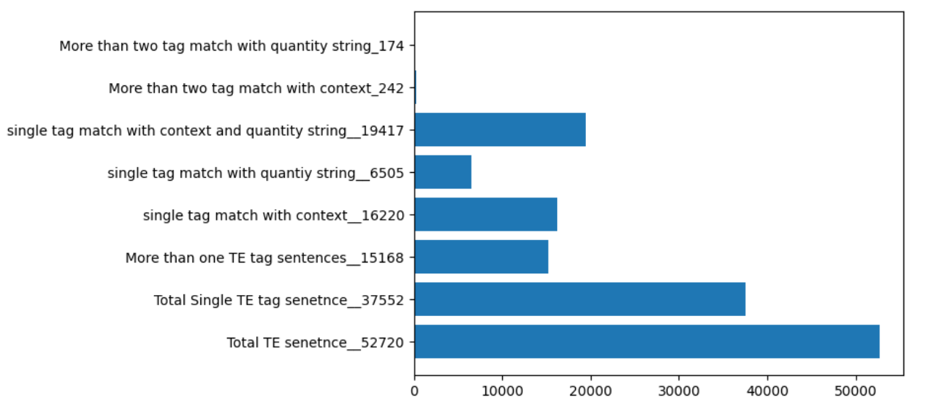
Statistics of datasets.

Slide 11
Training Dataset:
Getting those sentences only if temporal expression is available in quantity string then took verb as a event from context:
Took only temporal expression and event from sentences created dataset.
{'input': 'The first stop on his journey through many German prisons and concentration camps was the Welzheim concentration camp ( : de : KZ Welzheim ) , where he spent several weeks in the most miserable living and human conditions .'
'output': 'several weeks <sep> spent'}

Slide 12
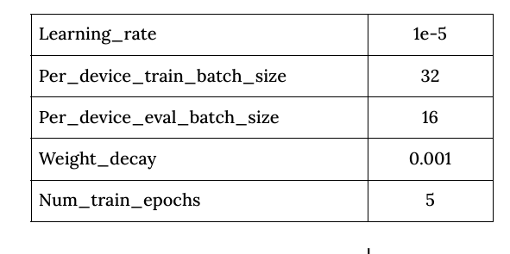
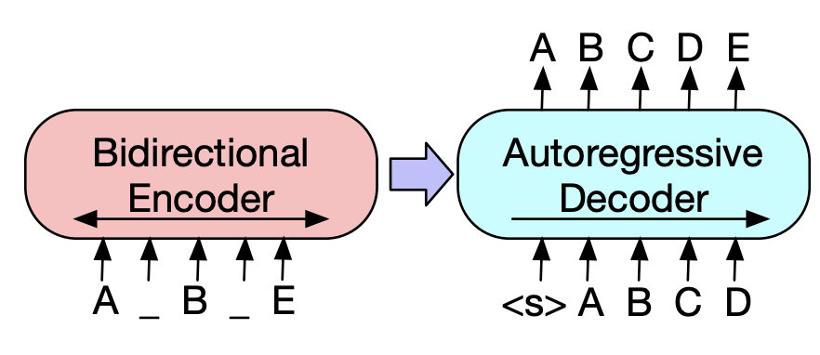
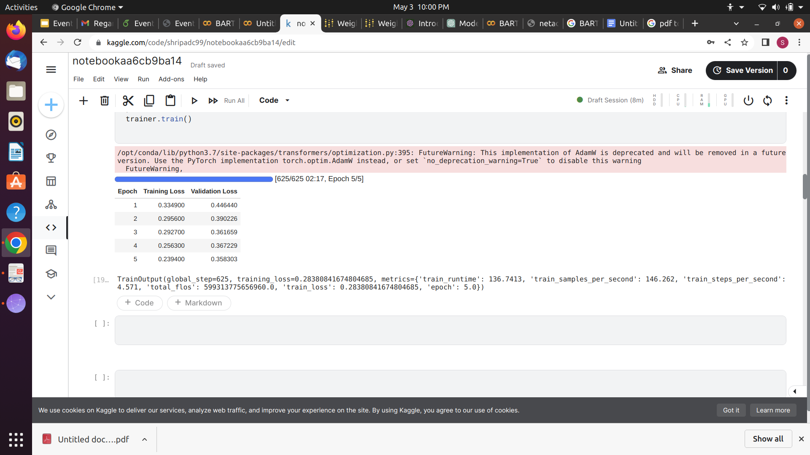
Facebook/BART-Base:
Facebook/BART-Base is a pre-trained sequence-to-sequence (seq2seq) model developed by Facebook AI Research (FAIR).
Facebook/Bart-base Architecture

Slide 13
Experiments:
Total 5k Sentences in own dataset
Split into train, test, validation data.
Tokenize the data.
Created training data, valid data and convert both into pytorch Dataset format.
Encoded in to vector format and train to the BART-Base Model.
Used Fine Tune method to for get Best parameter.

Slide 14
Evaluation:
Randomly select 100 sentences and manually find out temporal expression and related event then matched with generated label.
Precision for temporal expression=0.96
Recall for temporal expression=0.96
Precision for event=0.869
Recall for event=0.864

Slide 15
Conclusion:
BART model performed better in extracting temporal expressions and related events from the Qsearch dataset's sentences compared to the rule-based model.
Compared to the rule-based model, the BART model was able to capture more complex patterns and relationships between words in the sentences.
In conclusion, the experiment demonstrated that the BART model is a more effective approach for extracting temporal expressions and related events from the Qsearch dataset's sentences compared to the rule-based model.

Slide 16
Future work:
Increase the size of the training data.
Create better model for event extractor.
Add more complex Temporal expression and ambiguous event.
Use multiple model to find best accuracy.

Slide 17
Thank You

